Slide 1
Performance optimization of badly written SQL code
Enhancing Database Efficiency for Faster, More Scalable Applications
Uwe Ricken
https://github.com/db-berater/speedup-your-sql-code

Slide 2




PARTNERS & SPONSORS
ORGANIZERS
GOLD SPONSORS
PATRONS

Slide 3




Uwe Ricken db Berater GmbH
I am working with IT-systems since early 1990's and with the main focus on Microsoft SQL Server since version 6.0. I started with development of database applications in 1998 with a professional CRM-System based on Microsoft products (Microsoft Office and Microsoft SQL Server).
Since 2008 I'm focused exclusively on Microsoft SQL Server and working in 3rd level support teams for banks, insurances and global industries.
Since May 2013 I am a Microsoft Certified Master: SQL Server 2008 which was an amazing way into the depth of Microsoft SQL Server.
In July 2013 I have been awarded with the MVP Award for Microsoft SQL Server.
www: http://www.db-berater.de
email: uwe.ricken@db-berater.de
blog: http://www.sqlmaster.de
BlueSky: @sqlbambi

Slide 4
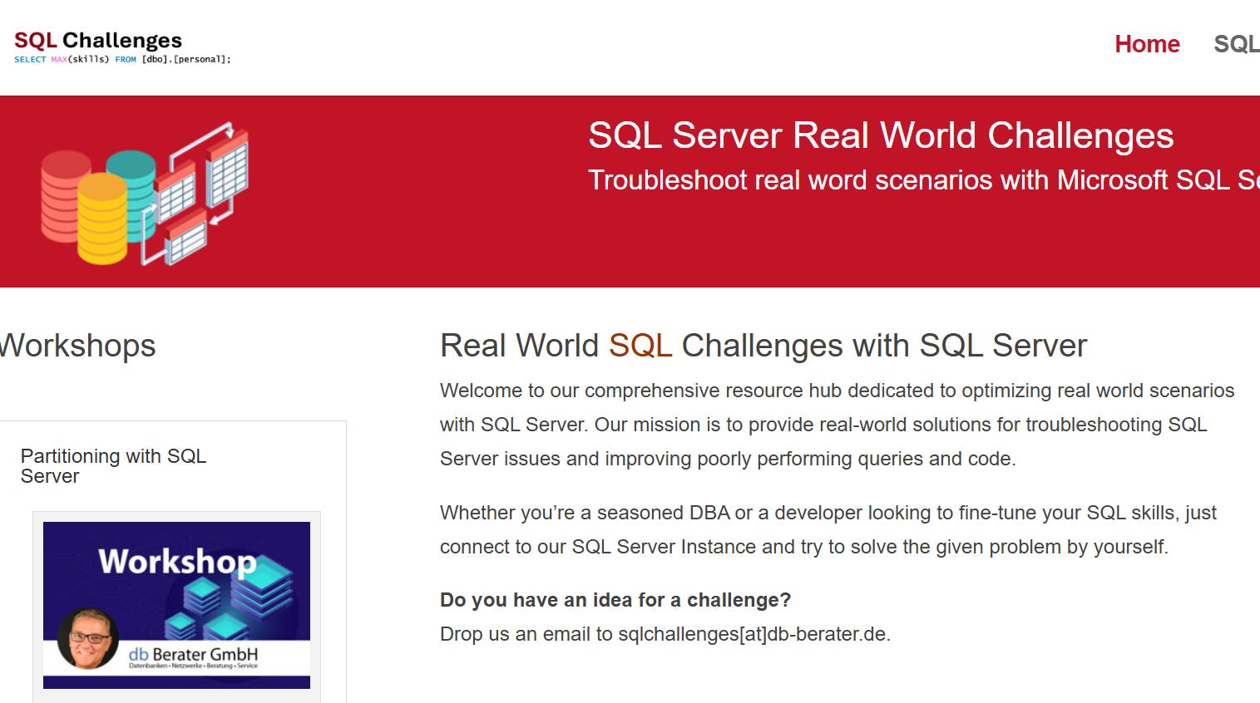
Challenge SQL Server real world scenarios
Get a challenge at least once a month
Connect to a provided SQL Server Instance
Load the challenge scenario
Try to solve it
Blog about your solution
Leave a link in the comments of the challenge to your blog post.
https://sqlchallenges.de

Slide 5
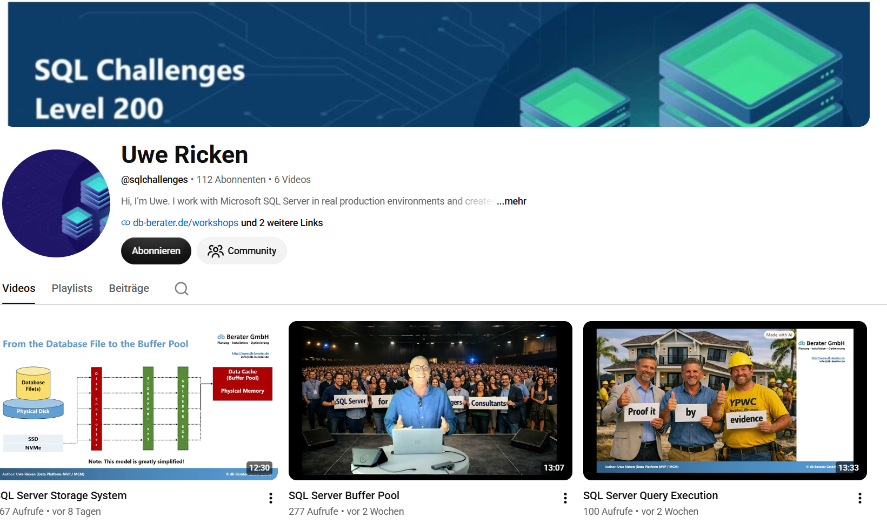
SQL Server for Juniors, Managers & Consultants
Learn SQL Server concepts through relatable real‑world analogies
Understand engine behavior without deep technical prerequisites
Bridge the gap between technical and non‑technical roles
Make performance, security, and architecture decisions easier to grasp
Build lasting intuition by connecting SQL Server to everyday situations
https://www.youtube.com/@sqlchallenges

Slide 6
Break Times
  09:00 – 10:30 Session
  10:30 – 11:00 Coffee Break
  11:00 – 12:30 Session
  12:30 – 13:30 Lunch Break
  13:30 – 15:00 Session
  15:00 – 15:30 Coffee Break
  15:30 – 16:45 / 17:00 Session

Slide 7
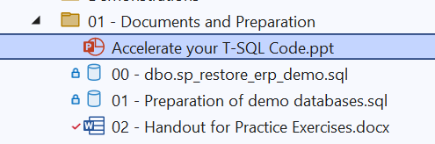
Action List
Download ERP_Demo Database
https://www.db-berater.de/downloads/ERP_DEMO.BAK
Download Workshop Solution
https://github.com/db-berater/speedup-your-sql-code
Open the SSMS Project File in SSMS
Execute the following scripts
  00 - dbo.sp_restore_erp_demo.sql
  01 - Preparation of demo databases.sql
Check the version of the demo database
SELECT * FROM ERP_Demo.dbo.get_database_help_info();;

Slide 8
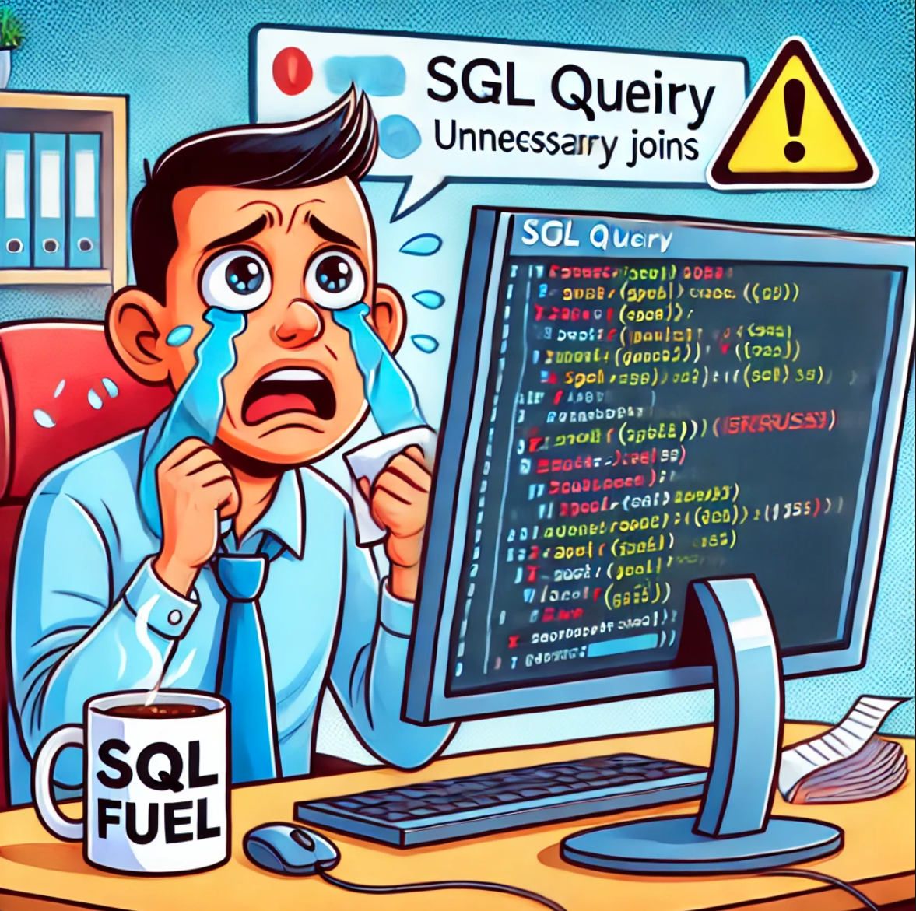
Make your SQL Code fast again
Why is SQL optimization important?
  Performance Improvement
    Efficient SQL code enhances database performance by reducing execution time and resource consumption.
  Resource Utilization
    Optimized SQL queries use fewer system resources like CPU, memory, and disk I/O for better scaling.
  Scalability
    Efficiently written SQL code can better handle increased data volume and user load.
  Cost Savings
    Reduced resource usage translates to cost savings, especially in cloud environments.
  Reliability and Stability
    Efficient queries are less likely to cause unexpected issues, such as timeouts or server crashes.

Slide 9
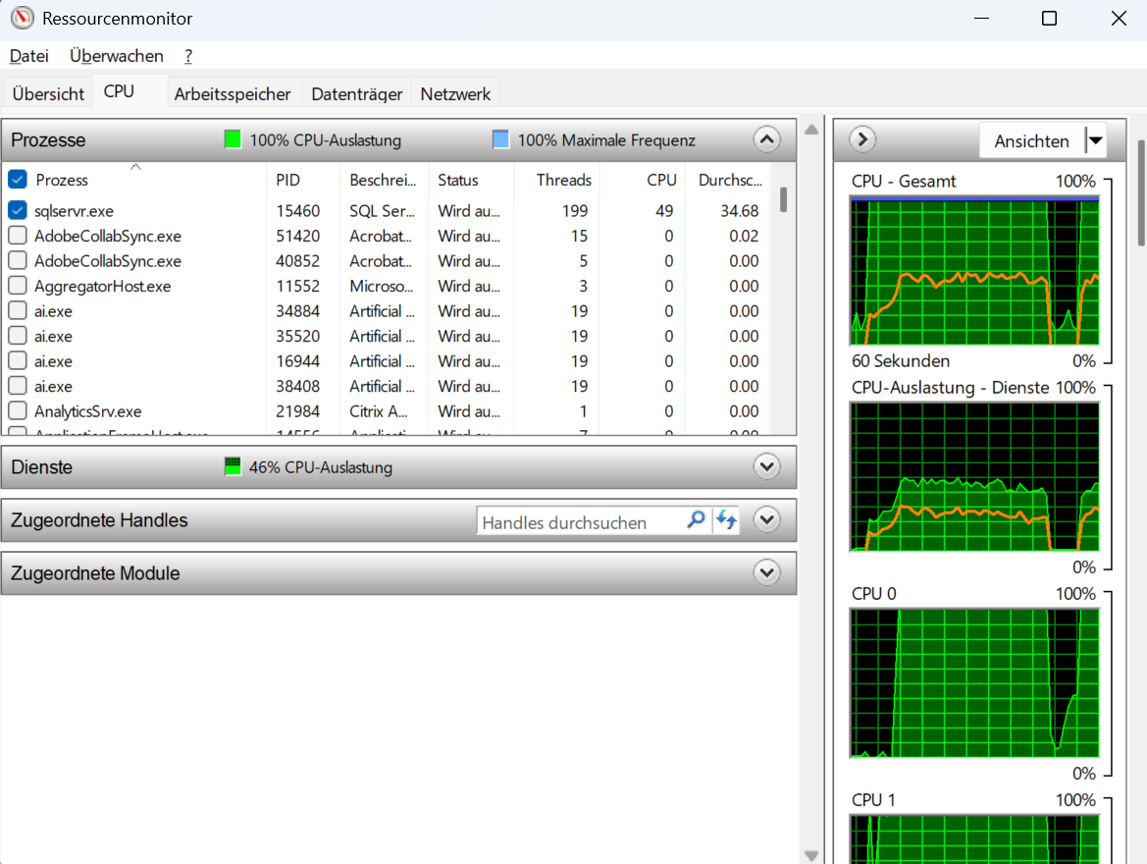
Make your SQL Code fast again
Objectives of this workshop
  Identification of common SQL errors and their impact on performance.
  Techniques to improve the efficiency of SQL queries.
  Practical examples and best practices to improve performance.

Slide 10
Key Topics
Tools and best practices
  using analysis and optimization tools
  recommendations for improving query speed.
Detecting bad SQL code
  Identifying inefficient queries and potential performance bottlenecks.
Optimization techniques
  reducing hardware resources (CPU / IO)
  reducing redundant queries
  avoiding unnecessary joins
  Using indexes

Slide 11
Tools ans Best Practices
The survival kit for developers who inherited ‘legacy’ SQL

Slide 12
Tools and best practices
Query Store
Performance Monitor / Resource Monitor
Windows Admin Center
Third Party Tools
  Redgate
  Idera
  Solarwinds
  …

Slide 13
Query Store
Source Tool for Query Performance

Slide 14
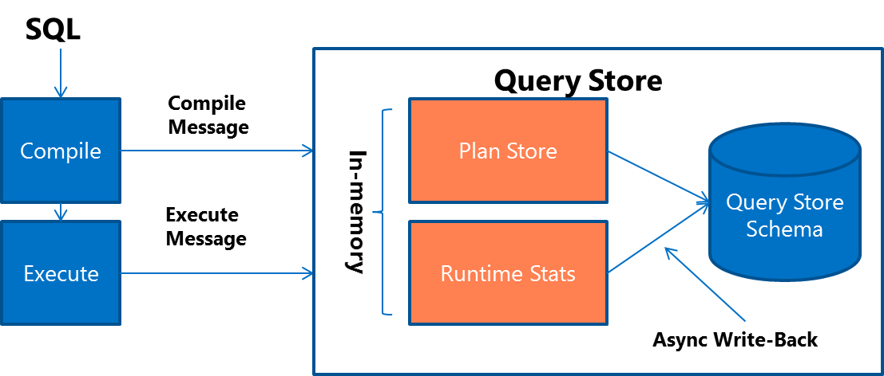
Query Store – Microsoft SQL Server
  When a query gets compiled for the first time, query text and the initial plan are sent to Query Store.
  When a query gets recompiled, the plan is updated in Query Store.
  If a new plan is created, Query Store adds the new plan entry for the query and keeps the previous ones along with their execution statistics.
  Upon the query execution, runtime statistics are sent to Query Store.
  During the compile and check for recompile phases, SQL Server determines if there's a plan in Query Store that should be applied for the currently running query.

Slide 15
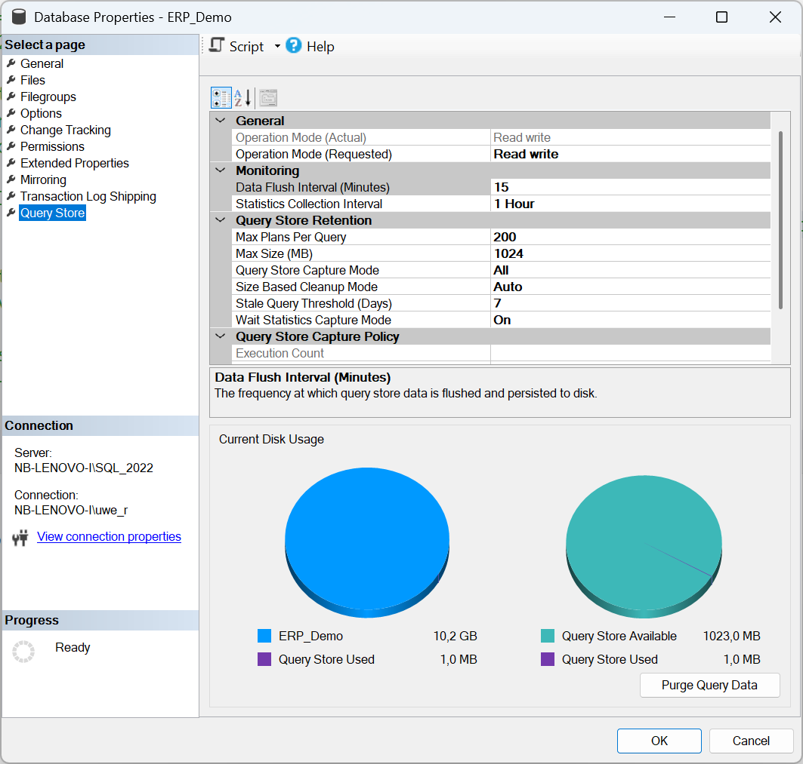
Query Store – Recommended Settings
Data Flush Interval 15 mins
Statistics Collector Interval 1 Hour
Max Size (MB) 1.024 MB
Query Store Capture Mode Auto
Stale Query Threshold 7 Days
Wait Statistics Capture Mode On

Slide 16
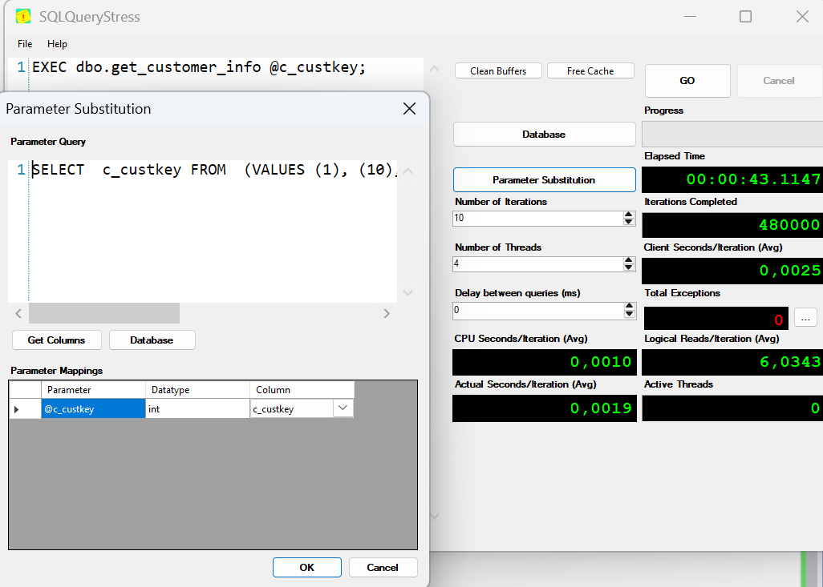
Query Store – Hands On/Demo
  open the script
  01 – demo of Query Store.sql
  follow the instructions of the instructor
  start SQL Query Stress
  Load the pre-configuratino set:
  demo of Query Store.json
  follow the next instructions of the instructor
  see the different execution plans in Query Store

Slide 17
Performance Monitor
Windows Admin Center
Source Tool for Resource Performance

Slide 18
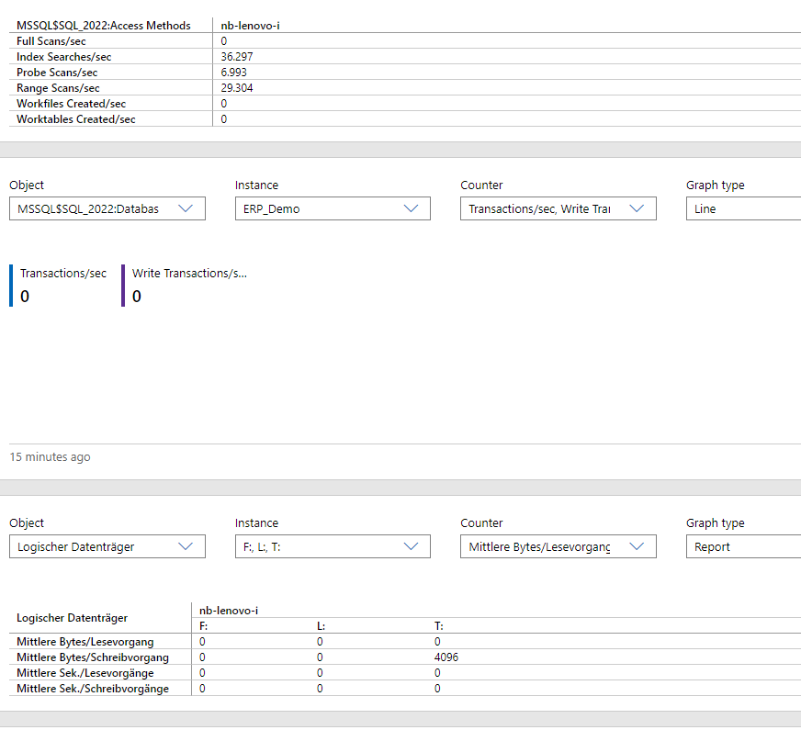
Windows Admin Center vs. PerfMon
Windows Admin Server
  Windows Admin Center is generally more suitable for administrators looking for an all-in-one, user-friendly tool for managing multiple servers
  ease of use
  centralized management.
Performance Monitor
  PerfMon remains a powerful tool for more in-depth, counter-specific monitoring on individual servers,
  use may be limited to specific scenarios where detailed monitoring is required without needing broader server management features.
Use Windows Admin Center for day-to-day management
Use PerfMon as a specialized tool for deep performance diagnostics

Slide 19
Windows Admin Center – Hands On/Demo
  open the script
  02 – demo of Windows Admin Center.sql
  follow the instructions of the instructor
  start SQL Query Stress
  Load the pre-configuration set:
  Windows Admin Center Demo.json
  follow the next instructions of the instructor
  see the different execution plans in Query Store

Slide 20
Scenario #1
When functions don‘t work

Slide 21
Scenario 1 - Problem Description
Description
  A job engine produces 24/7 for ~1.600.000 customers daily a class-type calculation. Since lots of customers must be recalculated every day, the job engine is working with 20 simultaneous processes.
  The developers are using a User Defined Function for the calculation of the class type!
  If there are no numbers for the given year, the UDF is using the previous year and reduce the classification by one step (e.g. an “A” in the previous year turns into a “B” for the actual year).
Problem
  If the job queue has a particularly large number of entries (> 1,000,000), performance drops and the system is no longer able to respond!
  We observe high latency on the system database TEMPDB when the number of entries raise (correlation?).

Slide 22
Scenario 1 - Preparation
Demo Configuration
  To demonstrate the problem, two tables ([dbo].[customers] and [dbo].[orders]) are used.
  A user-defined function dbo.calculate_customer_category() is implemented.
  It analyzes the orders for a customer (identified by customer number ([c_custkey]) and categorizes this customer.
Demo Setup
  execute the script 01 - scenario 01 – preparation.sql to prepare [dbo].[customers] and [dbo].[orders] with indexes and Foreign Key References.
  execute the script 02 - scenario 01 - user defined function.sql to create the user defined function.
  Execute the script 03 - scenario 01 - get_customer_classification.sql to create the stored procedure.

Slide 23
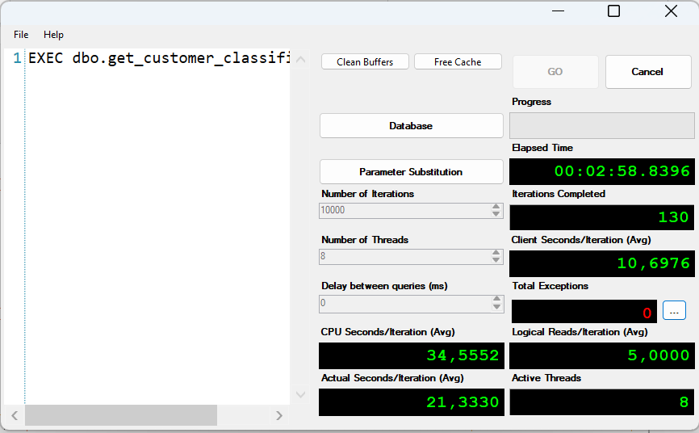
Scenario 01 – Test Environment
Load the stress test
Workshop - scenario 01.json
as configuration in SQLQueryStress
Load the analysis script
Workshop - scenario 01.json
into Windows Admin Server

Slide 24
Scenario 1 - Findings
Avoid multiple manipulations on temporary objects
This technique will reduce TEMPDB activity
Avoid NONSargable expressions and replace them with SARGable expressions
NONSargable expressions will lead to
  Residual predicates
  FULL scans
Avoid to use SCALAR or Multiline functions and try to rewrite them as an
Inline-Function.
Inline Functions can be interpreted by the compiler as relational operations within the same query (like views – but with parameters!)

Slide 25
Scenario #2
Stop using table variables and temporary objects

Slide 26

Scenario 2 – Problem Description
Description
  A software uses a table to queue jobs. Whenever a new job is to be queued, its details are written into this table. The table grows very quickly, as up to 100,000 jobs can be scheduled in one hour.
  A stored procedure manage the deletion of executed jobs.
  The first parameter specifies how many job entries should be deleted.
  The second parameter specifies the batch size.
Problem
  Sometimes the table is growing very fast, and the maintenance job cannot scale.
  The table is growing and the system suffers from performance problems.

Slide 27
Scenario 2 - Workflow
@items
Singleguid
(TOP @rowlimit)
EXEC @return_value = dbo.jobqueue_delete
@rowlimit = 3000,
@maxlimit = 50000;
dbo.jobqueue
TOP (@maxlimit)
WHERE generation
@itemportion
Exit!
No
Rowcount
> 0
UPDATE @items
DELETE dbo.jobqueue

Slide 28
Scenario 2 - Preparation
Demo Configuration
  To demonstrate the problem, two tables ([dbo].[jobqueue] and [dbo].[runtime_statistics]) are used.
  A stored procedure [dbo].[jobqueue_delete] handles the maintenance of the table [dbo].[jobqueue].
  The table [dbo].[runtime_statistics] stores the measures after each improvement.
Demo Setup
  execute the script 01 - scenario 02 – preparation.sql to prepare all table objects.
  execute the script 02 - scenario 02 – maintenance procedure.sql to create the user management procedure.
  Execute the script 03 - scenario 02 – stress query.sql to create the user defined function.

Slide 29
Scenario 2 - Findings
To check for data existence, use EXISTS instead of COUNT.
Remove unnecessary code structures for better reading and performance
Check indexes on the table and remove non used indexes
For multi-process patterns try to partition the job itself.

Slide 30
Scenario #3
When Indexes won’t work

Slide 31
Scenario 3 - Problem Description
Description
  A complex query will be executed 24/7 when users are accessing the web shop. This query evaluates a small part of the permission list for the logged in user.
Problem
  The query is consuming a lot of resources and especially at the first of a new month lots of new employees are requesting the web shop.
  This leads very often to timeouts and bad responding web shop experiences.
dbo.persons
uid_person | varchar(38) | NOT NULL | PK
…
centralsapaccount | nvarchar(12) | NULL | NCI
ccc_aliasname | nvarchar(255) | NULL
OR
dbo.sapusers
uid_sapuser | varchar(38) | NOT NULL | PK
uid_person | varchar(38) | NULL
accnt | nvarchar(38) | NULL | NCI
ccc_aliasname | nvarchar(255) | NULL

Slide 32
Scenario 3 - Preparation
Demo Configuration
  To demonstrate the problem, two tables ([dbo].[persons] and [dbo].[sapusers]) are used.
  A stored procedure [dbo].[dbo.stress_query] is used to stress the database.
Demo Setup
  execute the script 01 - scenario 03 – preparation.sql to prepare all table objects.
  execute the script 02 - scenario 03 – stress query.sql to create the stored procedure.

Slide 33
Scenario 3 - Findings
Avoid creating too deep nesting with SUB-Selects. They are difficult to read and may not be ideally optimized by the Query Optimizer.
OR statements on different attributes cannot always be used optimally by the query optimizer, despite both attributes being indexed. This is especially true if the attributes have a similar selectivity (cardinality).
To use the indexes on the attributes efficiently, it is better to use UNION ALL instead of OR.

Slide 34
Scenario #4
Triggers, Functions, Deadlocks - Exodus!

Slide 35
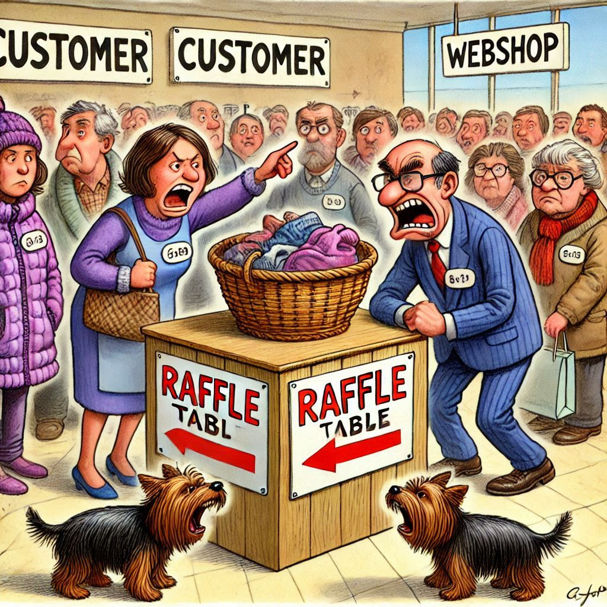
Scenario 4 – Problem Description
Description
  A customer's web shop runs without any complaints from customers during "normal" days.
  As soon as special sales promotions are started (e.g. Black Friday, fire sale, ...), the system's performance collapses and customers complain that it takes a long time for placing an order in the system.
Problem
  During peak times, the system reacts very slowly and cannot be used in some cases.
  Customers often abandon their purchase attempts in frustration.
OR

Slide 36




Scenario 4 - Workload
webshop.insert_order_record
SQL
webshop.customers
webshop.orders
webshop.lineitems
webshop.update_order_record
webshop.delete_order_record
Job Server

Slide 37
Scenario 4 - simulation
EXEC webshop.insert_order_record;
01: Insert data into webshop.orders
02: Calls trigger
03: Calls function
05: Insert data into webshop.lineitems
04: Update data in webshop.customers

Slide 38
Scenario 4 - Findings
When deadlocks occur, try first to increase performance to hold locks for a short time!
Scalar Functions should return a value without using table variables because this leads to heavy usage of TempDB (System Database).
If triggers are required, you should avoid cursors which are processing the affected data “row by row”.
If possible, remove triggers by replacing them with an effective user defined function or create a view which is doing the math of the triggers.

Slide 39
THANK YOU!
I am looking forward for your feedback!
Uwe Ricken

Slide 40


